Slide 1
SMART BRIDGE 2025 TITLE PAGE
PROJECT NAME: HematoVision: Advanced Blood Cell Classification Using Transfer Learning
Subtitle: A Deep Learning-Based Approach
team members: Lomada Anusha
Maddileti Nandini
Mangali Divya
Muttineni Samatha
Nethipichola Ganga devi
College Name: KLM COLLEGE OF ENGINEERING FOR WOMEN

Slide 2
Introduction
Blood cell classification is crucial for diagnosing various diseases like leukemia, anemia, and infections.
Manual analysis is time-consuming and error-prone.
HematoVision leverages AI to automate and enhance the accuracy of blood cell classification.

Slide 3
Problem Statement
Traditional blood smear analysis is:
Labor-intensive
Requires expert pathologists
Prone to human error
Need for a faster, accurate, and automated system using AI.

Slide 4
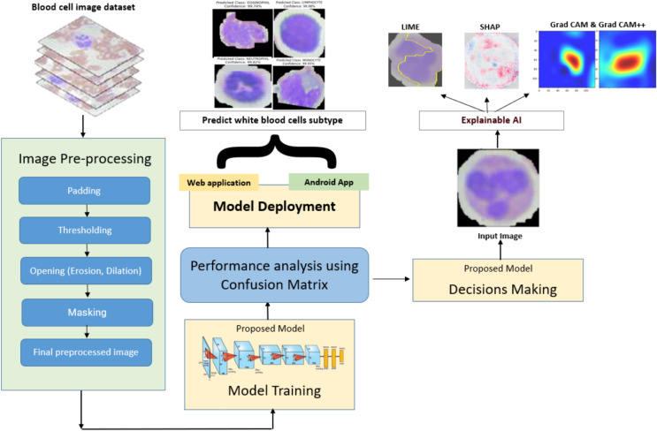

Slide 5
Objective
Develop a deep learning model using transfer learning to classify different types of blood cells.
Achieve high accuracy and efficiency while reducing the dependency on manual methods.

Slide 6
System Architecture
input Image → Pre-processing → Feature Extraction (Transfer Learning Model) → Classification Layer → Output (Cell Type)

Slide 7
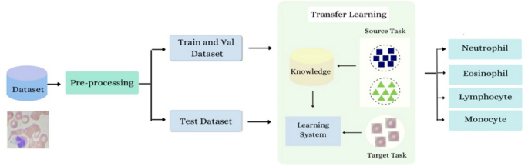

Slide 8
Technologies Used
Programming Language: Python
Frameworks: TensorFlow, Keras
Pre-trained Model: VGG16 / ResNet50 / MobileNet (choose based on your project)
Dataset: Blood smear images (e.g., BCCD Dataset)
Tools: Jupyter Notebook, Google Colab, OpenCV, Matplotlib

Slide 9
SDLC (Software Development Life Cycle)
SDLC Model: Agile / Iterative Model
Steps Followed:
Requirement Analysis
Data Collection & Preprocessing
Model Selection (Transfer Learning)
Training & Testing
Evaluation & Deployment

Slide 10
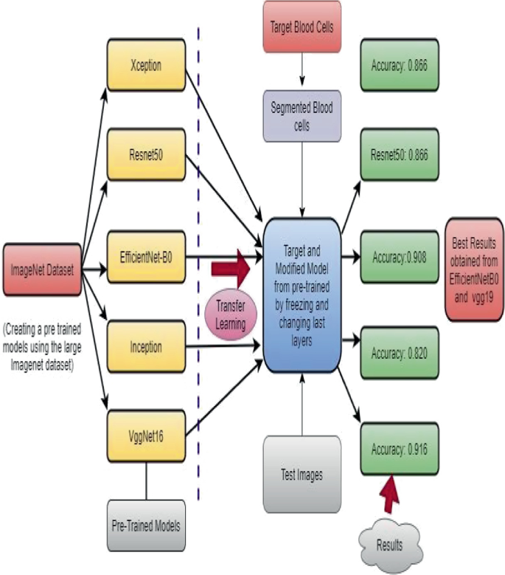

Slide 11
Key Features
Uses pre-trained CNN models for faster training
High classification accuracy
Handles multiple blood cell types
Scalable and can be deployed as a web/app tool

Slide 12
Advantages
Faster and consistent results
Reduces workload on medical experts
Can be used in remote or resource-limited settings

Slide 13
Limitations
Limited by dataset quality
Might struggle with overlapping or unclear cell images
Needs retraining with new or rare types of cells

Slide 14
Future Scope
Extend model to classify more diseases
Integration with hospital information systems
Real-time mobile app for instant analysis
Include WBC sub-type classification

Slide 15


